Slide 1
ENGLISH: WRITING CONCLUSIONS
Notes:
Speaker:
Welcome to our short presentation on how to write an effective conclusion for a critical essay. I will take you through what a conclusion is, what information you need to include in a conclusion as well as showing you how to take a bad conclusion to a good one in a few simple steps.

Slide 2
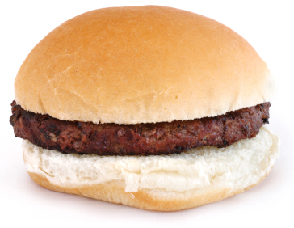
Structuring an Essay
The main body of the essay – usually 3 section (NB sections not paragraphs). This is the tasty bit that gets you the marks.
An Introduction
The bits that hold the whole thing together.
A Conclusion
Notes:
Speaker:
Critical essays make up 20% of your grade in National 5 and Higher English and is something you do from S1. These essays are very carefully structured to ensure that learners are able to effectively answer the question to the best of their ability. A conclusion is just one part of this structure. However, it is a vital part as it helps to hold the whole essay together – like the bottom bun in a hamburger.

Slide 3
What You Need to Know
Acts as a summary of your essay.
Answers the question.
Brings your essay to a close.
Notes:
Speaker:
The first thing you need to understand is the purpose of a conclusion. A conclusion is how you bring your essay to a close and show your marker – who won’t always be the teacher who has taught the text to you – that you have answered the essay question. During the senior phase – when you are studying National 5 and Higher – you have to learn to do this under timed conditions and often the conclusion is the thing that suffers as a result. You MUST have a conclusion for your essay to achieve well.

Slide 4
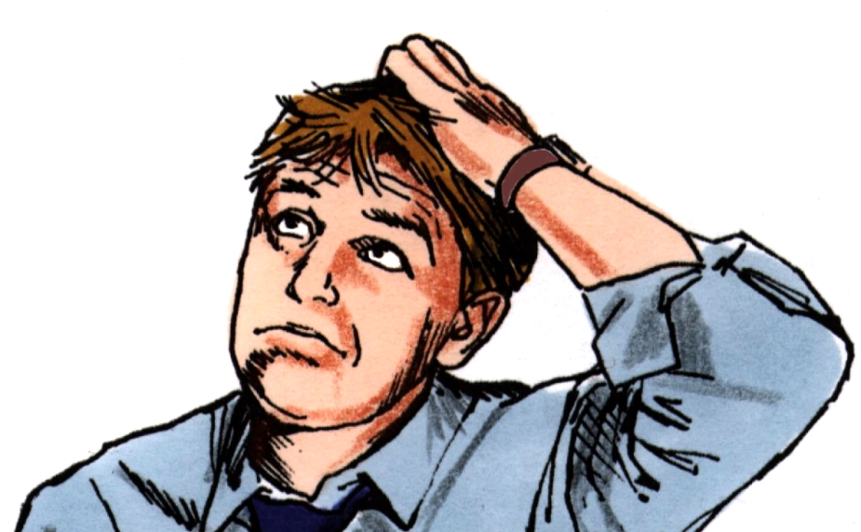
This Photo by Unknown Author is licensed under CC BY
Notes:
Speaker:
But what do you actually need to include in a conclusion?
The simple answers is ATTACK.

Slide 5
How To Write A Conclusion
AUTHOR​
TEXT​
TASK​
ANSWER THE QUESTION BY​
CONCLUDING​
KNOWLEDGE
This Photo by Unknown Author is licensed under CC BY
Notes:
Speaker:
Attack stands for
Author – where you mention who created the text.
Text – just like you did with the introduction you need to mention the name of the text again.
Task – mention again the question you are answering – this is important as the next bit is you actually answering the question quite clearly.
Answer the questions by concluding knowledge – is where you are summarising everything you have mentioned in your essay to show once more that you have answered the question.

Slide 6
Example Conclusion
In conclusion the main character of the TV episode “White Christmas” is a hero who is not all he seems. The director initially makes him seem like he is a good guy and it is only when we get to the end that we realise that we were wrong.
AUTHOR​ X
TEXT ​
TASK​
ANSWER THE QUESTION BY​
CONCLUDING​
KNOWLEDGE X
Notes:
Speaker:
Is this a good or bad example of a conclusion? Let’s go through ATTACK and see if it has all the bits and pieces needed.
Firstly there is no mention of the director/writer’s name and therefore they haven’t mentioned who the author is.
Whilst they have mentioned the name of the actual episode they watched they haven’t actually mentioned the name of the series it came from so this is not as developed as it could be.
There is a vague reference to the task but this is too generally for a conclusion to an essay that has just spent the last 800 words talking about the character.
There is a lack of any detail of what has been discussed in the essay about this character and how he was shown to be a hero and then changed toa villain.
Overall this conclusion is a big fail. So how could it have been better?

Slide 7
Conclusions
Bad
Better
In conclusion the main character of the TV episode “White Christmas” is a hero who is not all he seems.
In conclusion, Matt Trent in Black Mirror’s “White Christmas” is a hero who is not all he seems.
Notes:
Speaker:
Lets take it a section at a time - the opening sentence. By adding this red section the learner has clearly mentioned the character that the essay has been focused on and the name of the series it comes from.

Slide 8
Conclusions
Bad
Better
The director initially makes him seem like he is a good guy and it is only when we get to the end that we realise that we were wrong.
Tibbetts’ clever use of various direction and techniques in the opening sequence paint Matt to be hero of the story, due to his more likeable tendencies, rather than Joe Potter who is initially presented as a sullen, introverted man. However, as the episode progresses, it reveals Matt’s more sadistic side through his sexual deviancy and torture of others, which ultimately leaves the audience in no doubt that he is a hero who is not wholly good
Notes:
Speaker:
To develop the reference to task you should mention the techniques the author has used to create the character they way he has. This has been highlighted yellow for you. Notice how in the better example that instead of talking about the director in a general terms the better answer mentions his name clearly.
The rest of this section shows the learner trying to answer the question by stating quite clearly how the author has made the audience believe one thing before showing the other side to the character which was the focus of the question. Here we see very easily the points the learner will have made throughout the essay about the develop of this character.

Slide 9
All Put Together
In conclusion, Matt Trent in Black Mirror’s “White Christmas” is a hero who is not all he seems. Tibbetts’ clever use of various direction and techniques in the opening sequence paint Matt to be hero of the story, due to his more likeable tendencies, rather than Joe Potter who is initially presented as a sullen, introverted man. However, as the episode progresses, it reveals Matt’s more sadistic side through his sexual deviancy and torture of others, which ultimately leaves the audience in no doubt that he is a hero who is not wholly good
Notes:
Speaker:
Using ATTACK we can clearly see how the conclusion has developed from something that adds nothing to the essay to something that leaves the marker without a shadow of doubt that they have answered the question.

Slide 10
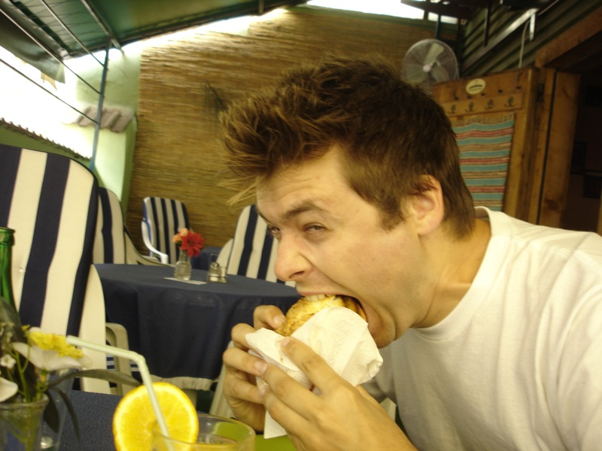
Thanks For Reading
http://mintlawacademy.aberdeenshire.sch.uk/English/
Notes:
Speaker:
Now you know how to write a conclusion go on, attack that critical essay.
If you need anymore help and advice on improve your English skills please head to the Mintlaw Academy English Faculty page of the school’s website for other dedicated videos.

